Slide 1
Price Estimation of Used Cars*
ML Project Presentation
Abdullah Arif & Tahmooras Khan
*Price Prediction and Worth Determination of Used Cars in Pakistan

Slide 2
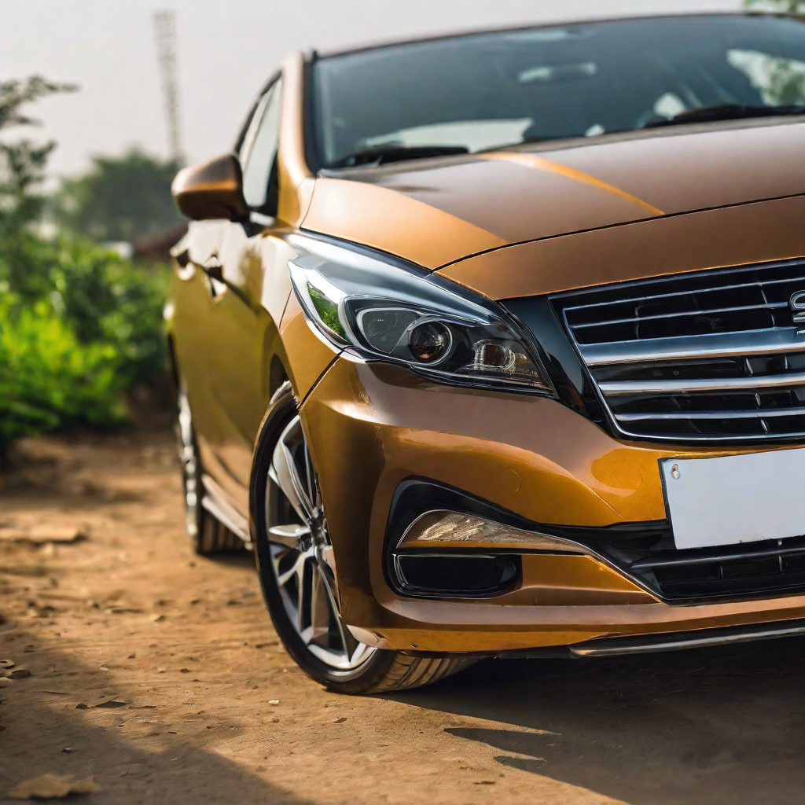
Welcome!
Let the odyssey begin!

Slide 3
Problem Statement
01
Why have we built this?

Slide 4
The Challenge:
Audience
There is no reliable and transparent way to estimate fair value of used cars In Pakistan. This results in information disparity and inefficiency in resale transactions.
Significance
Valuable insights for buyers and sellers
Helps informed decision making
Facilitates fair price negotiation
Car buyers and sellers
Insurance Companies
Investors

Slide 5
Dataset
02
PakWheels.com

Slide 6
Data Source:
Muhammad Waqar Gul, a data science enthusiast, scraped the information, which contained over 80,000 used automobiles on Pakistan's largest online marketplace PakWheels, in October 2022. It has 17 columns for purposes including exploratory data analysis, visualization, and machine learning. Link
Pakwheels.com
Mr. Waqar Gul
Kaggle.com

Slide 7
89,956
74,640
100+
Rows in raw data
Rows in cleaned data
Unique Car Models

Slide 8
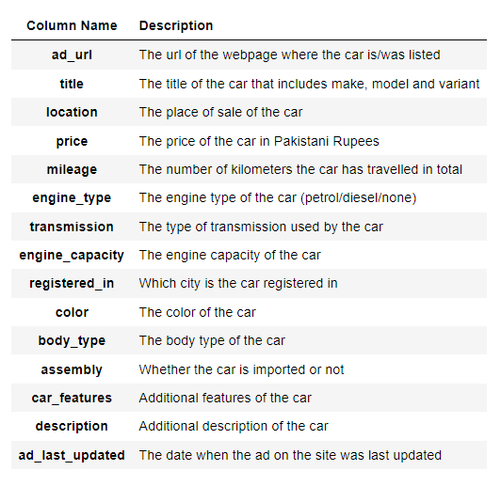
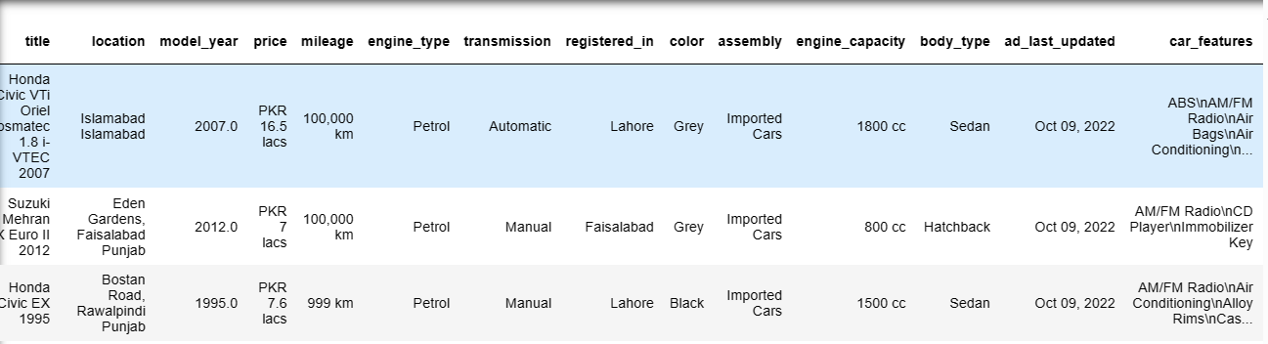
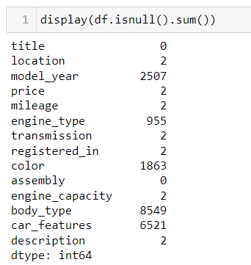

Slide 9
Data Preprocessing and Transformation
03
Making data useable

Slide 10
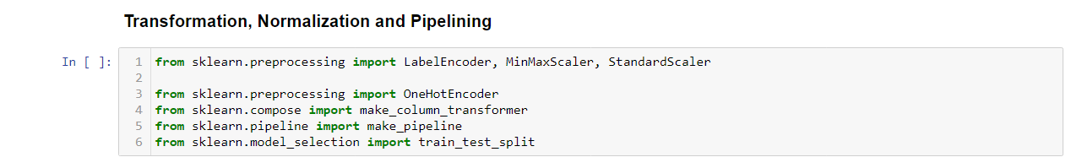
Important Libraries:

Slide 11
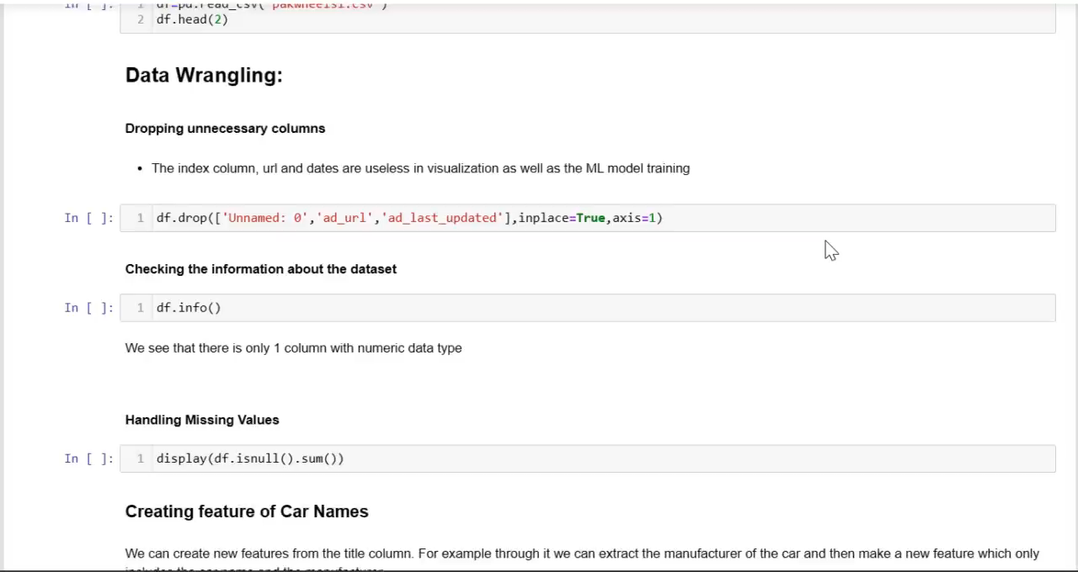

Slide 12
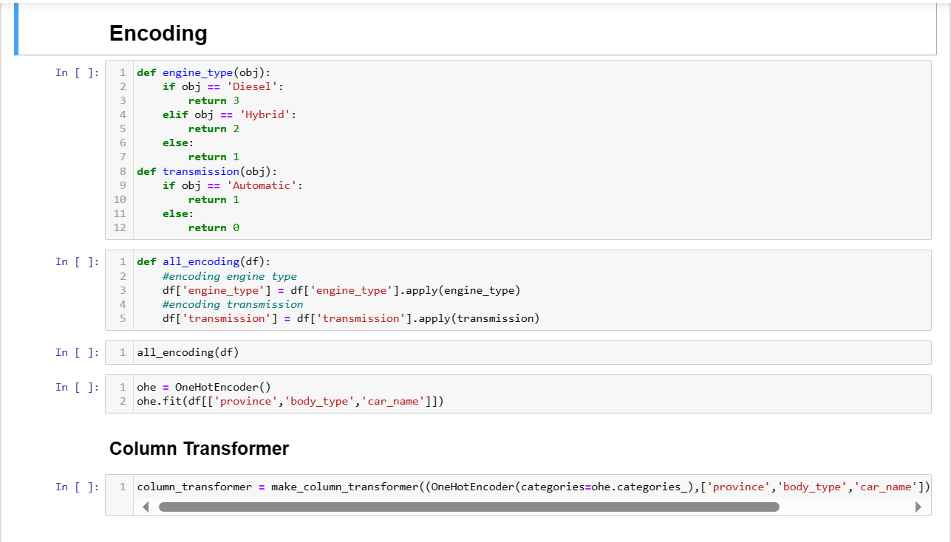

Slide 13
Exploration and Visualization
04
EDA that discloses the hidden insights

Slide 14

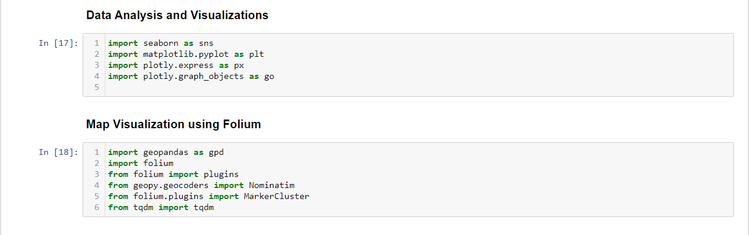

Slide 15
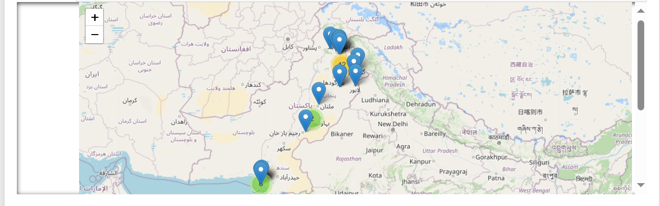
GeoSpatial Analysis

Slide 16
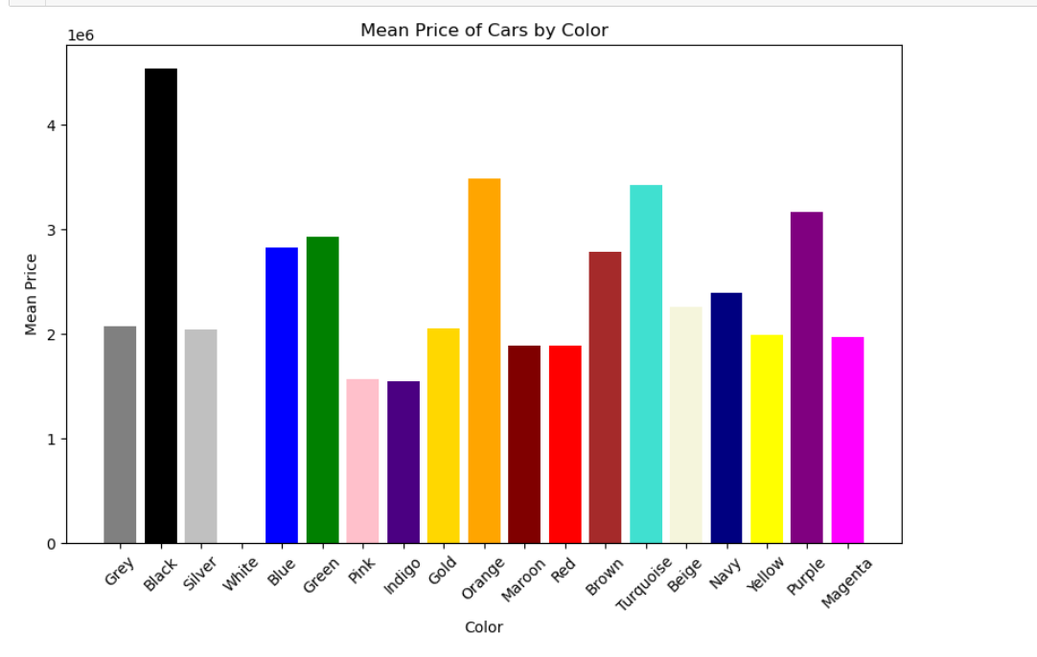
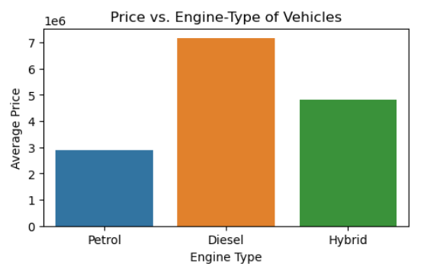
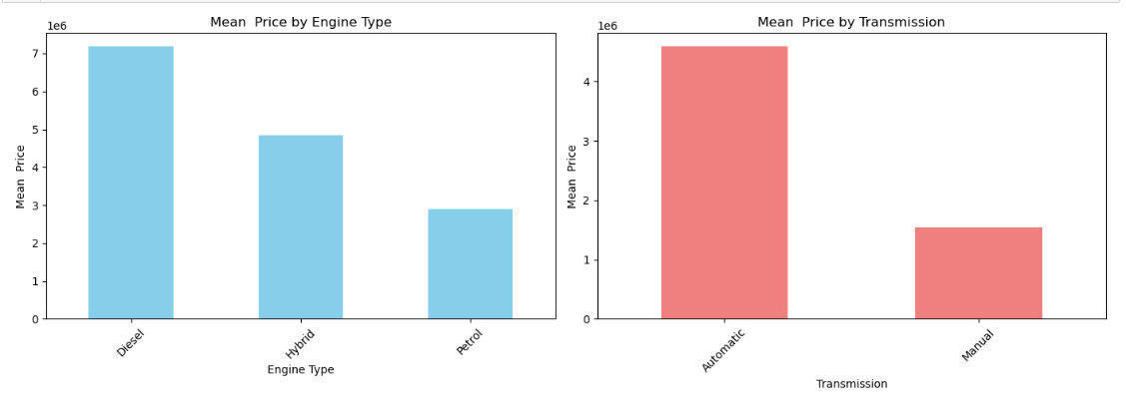
Bar Charts

Slide 17
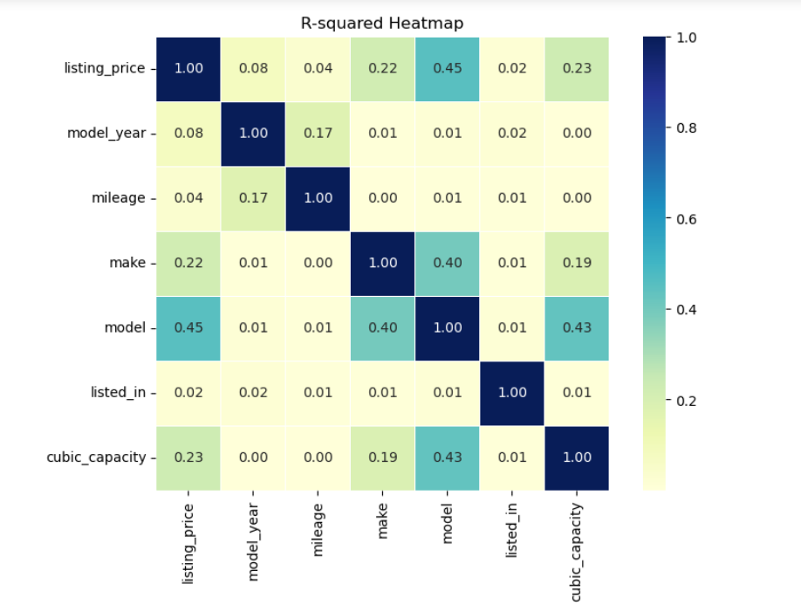
Correlation Matrix

Slide 18
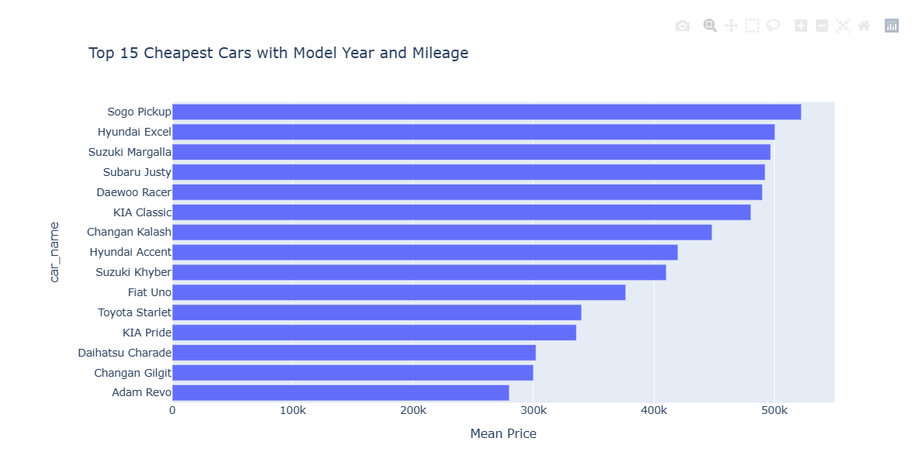
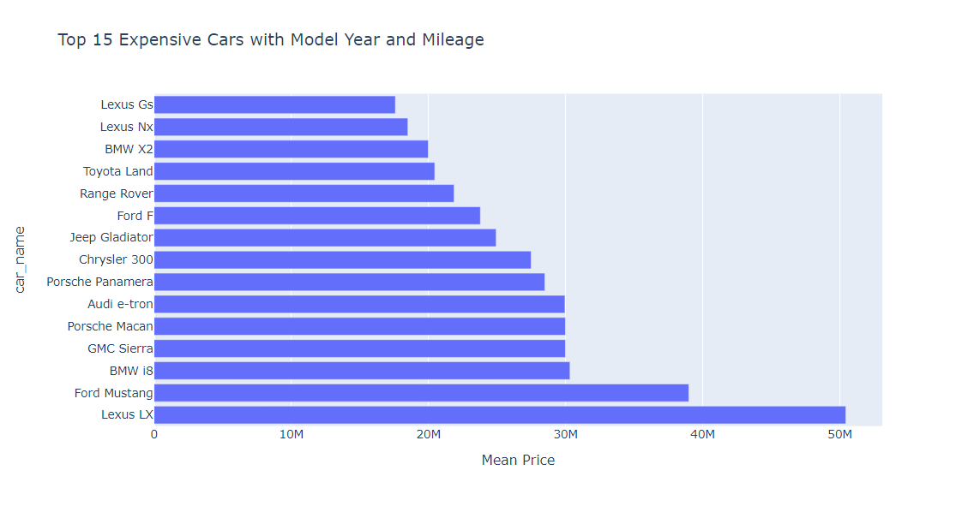

Slide 19
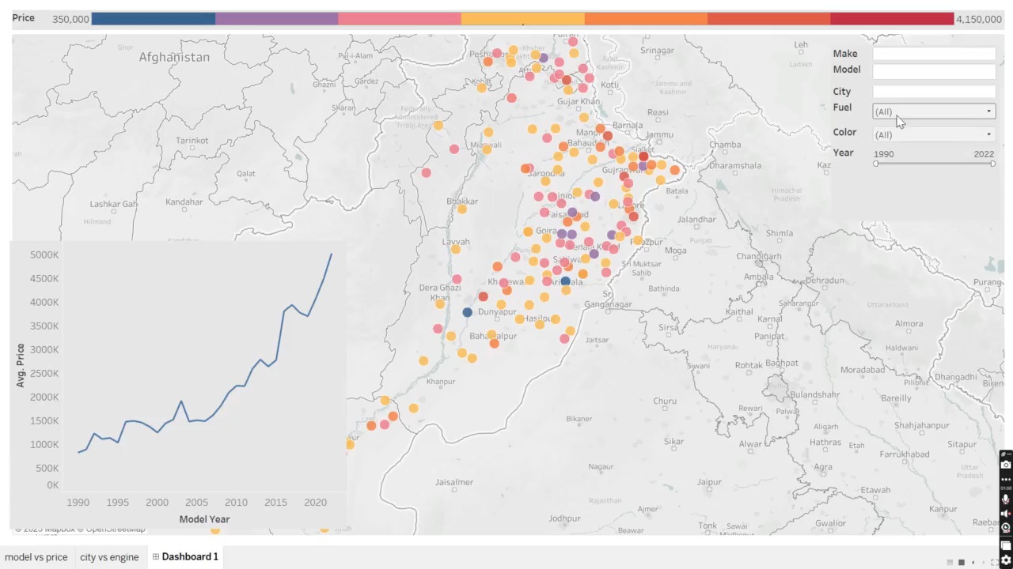

Slide 20
Model Selection & Training
05
The Winner wins the data!

Slide 21
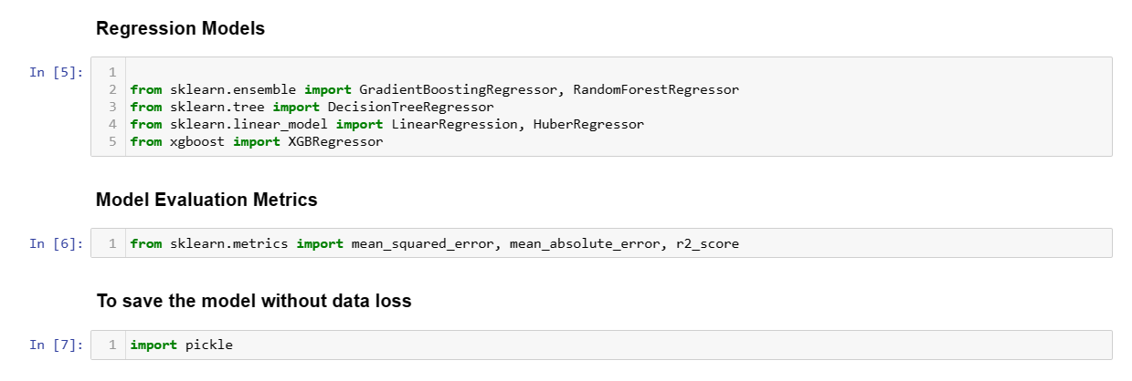

Slide 22
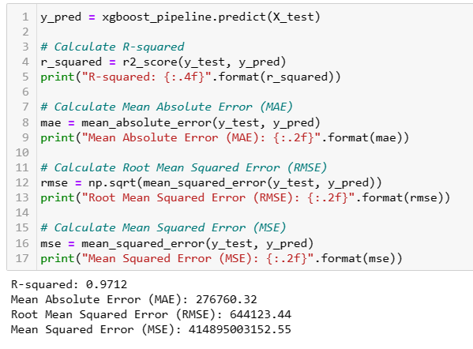
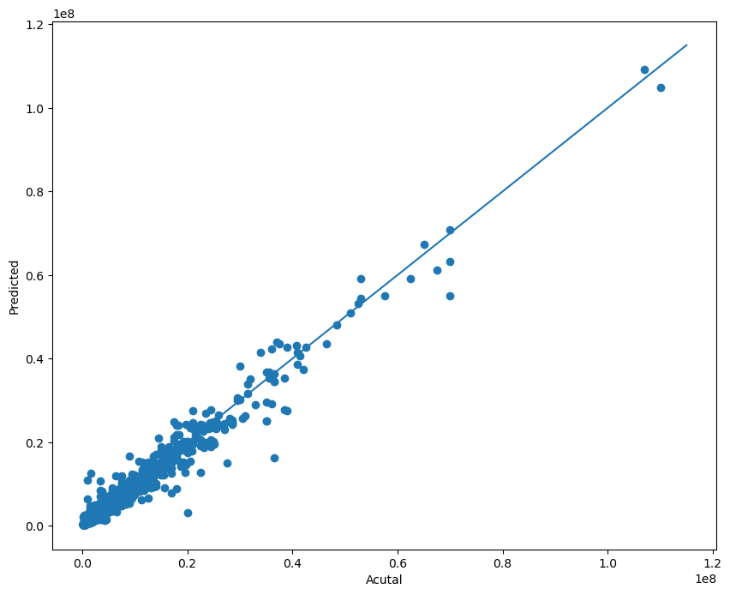
Extreme Gradient Boost Regressor – XGB Regressor

Slide 23
THESE ARE THE PERCENTAGES!
87%
97%
51%
Decision Tree
XGB Regressor
Linear Regression

Slide 24
Deployment
06
Applying it to the web!

Slide 25
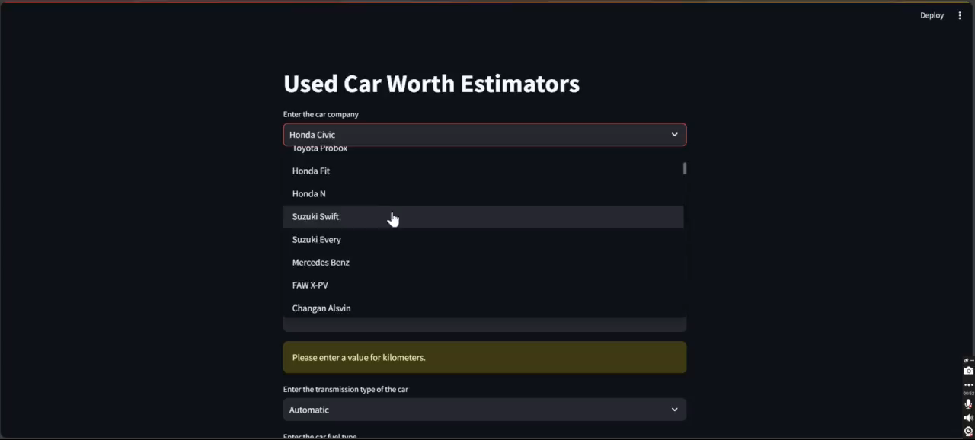

Slide 26
That’s All!
Keep training, testing and deploying!

Slide 27
THANKS!
Do you have any questions?
abdullah.arif@algofig.com
l227484@lhr.nu.edu.pk
Algofig.com

